Slide 1
Experimental parameters: ferromagnetic colloid under magnetic field

Slide 2
Experiment
Magnetic particle
Size and number (initial configuration, Why not forming a chain at the beginning)
Magnetic moment, amplitude
Magnetic field,
rotating frequency, (x,y,z)
Magnitude
Liquid
Viscosity, Reynolds number
How to control the mode (Amplitude, frequency)

Slide 3
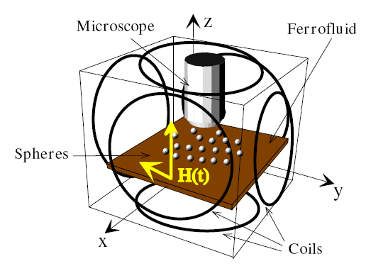
Self assembly-variable fields
H_{y}
Rotating field in the plane f = 10-100 Hz
Constant field normal to the plane
H_{x}

